Slide 1
Decision Intelligence Application Daniele D’Avino - MLE10 - Industry Project
Notes:
This is the slide where you actually SAY your 1-2 sentence elevator pitch. Engage your audience!!

Slide 2
Agenda
Problem
Solution
Demo
Making of
Data
Models
MLE Stack & Architecture
Conclusions & Next Step
Appendix

Slide 3
Problem
Actual stage:
highly competitive industry environment
challenging macroeconomics factors (inflation, interest rate)
and moreover:
5%: median revenues loss due to fraud actions*
10%: median revenues loss for not offering more tailored solutions to customers**
*2022 ACFE Report
**2021 McKinsey Report
Notes:
Specify what Problem is being solved, and ensure that everyone is in agreement as to Why that’s a problem.

Slide 4
Solution
With the Decision Intelligence Application (DIA) it’s possible to:
quickly and precisely identify fraud and fraudsters;
cluster customers into homogeneous groups (Personas) in order to offer them more personalized solutions!
Notes:
Specify what Success looks like, and for what Audience.

Slide 5
Solution – A closer look
The DIA is built for
extract insights from the dataset (descriptive statistics, network analysis*, factor analysis**)
compute:
the Fraud Probability Score for a single transaction or a bulk and retrain the ML models if necessary;
the Customer Personas label for a single customers or a bulk.
The application queries purpose-built API endpoints for getting the results.
* Knowledge Graph built from an adjacency list on selected nodes and “user-defined” relationship (edges)
** Multiple Correspondence Analysis

Slide 6
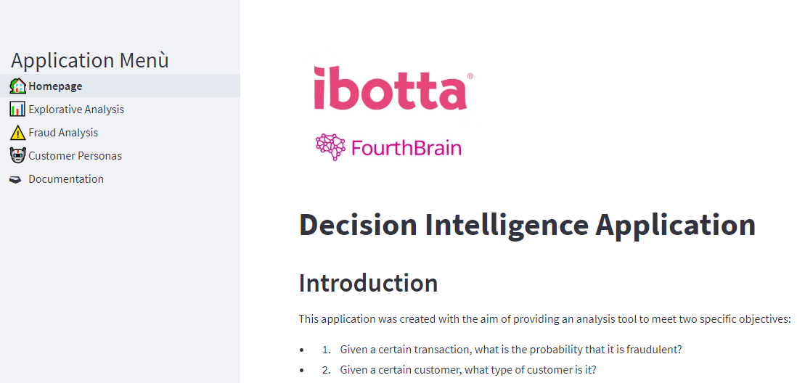
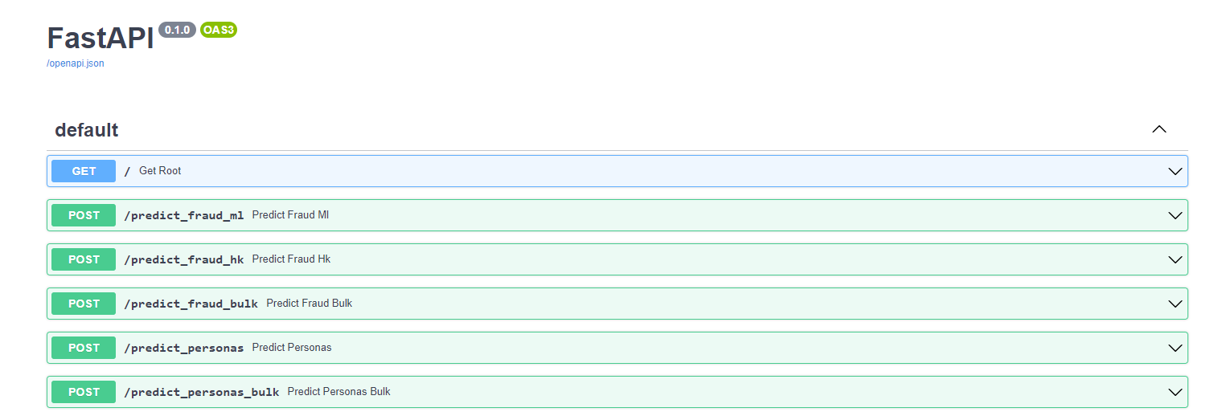
Demo: Decision Intelligence Application
The frontend
The backend

Slide 7
Making of: The Data
Dataset with the following characteristics were used to develop the solution:
structured mixed type data
presence of the fraud label
What information is stored on it?
transactions (amount, product type, etc…)
payments (card type, card issuer, region, etc…)
customers behavior on the website
customers devices (browser used, os, user agent, IP, etc…)

Slide 8
Making of: The Model - Fraud Detection
A Bayesian expert system was built to simultaneously integrate the strengths of two different modeling approaches:
Rule based
Machine Learning
Fraud Probability Score
An approach for emulating and exploiting human domain knowledge.
An approach for discovering hidden patterns and relationships.
A Bayesian average of the scores obtained from the previous steps.
Model results on test set:
Precision: 0.93
Recall: 0.85
F1: 0.88

Slide 9
Making of: The Model - Customer Personas
Identify Personas
Predict Personas
Customer CTA
A clustering algorithm is used to identify groups of customers (Personas) with similar purchasing and Web browsing behaviors.
(Silhouette Score: 0.21)
The cluster labels are used for classifying new customers into identified Personas.
Specifically dedicated promotional campaigns can be built for each Personas.

Slide 10
MLE Stack
Development side:
Docker Compose for orchestrating 3 Docker containers:
JupyterLab: preprocessing and models building
Streamlit (+ Ploomber [Airflow]): developing frontend of the web application and rescheduling notebooks run
FastAPI: developing the backend
Production side:
Deploy on GCP Cloud Run of two containers (backend & frontend)
CI/CD deployment from Github to Cloud Run with Cloud Build

Slide 11
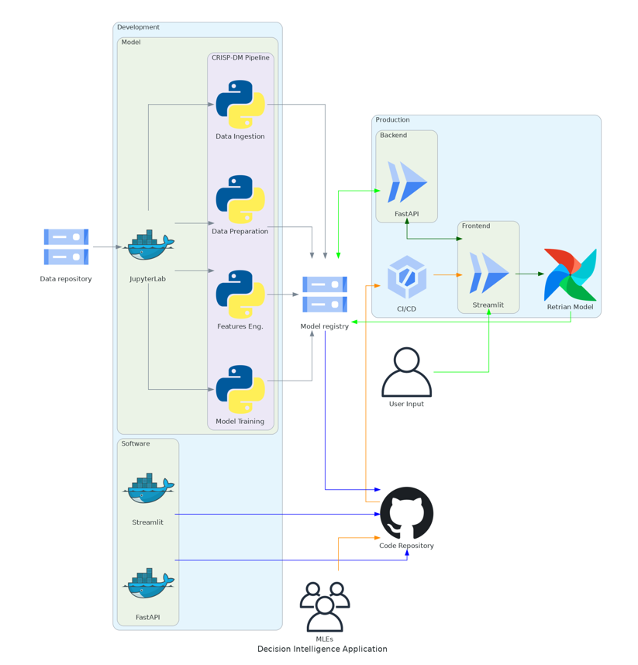
MLE Architecture

Slide 12
Conclusions
The presented framework is a methodological solution that can be applied, maintained, and adapted to the true data model of future consideration.
This solution can be used in both batch and real-time ways.
Next steps:
It will be necessary to improve the UX and the ability to better customize model creation.
Test different modeling choices for fraud detection: Naive Bayes, Variational Autoencoder, GNN.
Move files into a Cloud Storage (rather than Google Drive).
Notes:
This is where you can tell funny stories about the stupid things you did!
This is also the slide where you might convey the difference between what you set out out to do, and what you actually did.

Slide 13
Thank you for listening!
Questions?

Slide 14
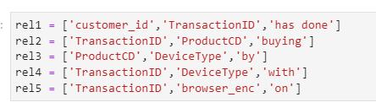
Appendix: Knowledge Graph
Create the following relationship:
Build adjacency list on the previous selected nodes and edges.

Slide 15
Appendix: The Model - Focus on Rule Based
Features, selected by domain knowledge, are log and beta-inverse scaled.
Weighted average of previous processed features. Weights decided by experts.

Slide 16
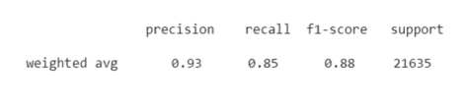
Appendix: The Model - Focus on Machine Learning
Adversarial Validation for checking distribution shift between validation and test set.
Undersampling majority class for the label on the training set.
Imputation and Scaling for continuous and categorical variables on training set for avoiding data leakage.
As supervised model choose Gradient Boosting Classifier with Grid Search and Cross-Validation. These are the results on the test set:
Calibration of the best model estimator.
Features Importances for explainability.

Slide 17
Appendix: The Model - Focus on Customer Personas
K-prototypes as clustering algorithm for dealing with continuous and categorical data:
continuous data: Euclidean distance
categorical data: Hamming distance
Silhouette score computed on distance matrix derived from Gower distance. (Score: 0.21)
These are the Personas:
Cluster 0: Regular Desktop User with Credit Card
Cluster 1: Occasional High-value Desktop User with Debit Card
Cluster 2: Frequent Low-value Mobile User with Debit Card
Cluster 3: Occasional High-value Mobile User with Credit Card

